Slide 1

San Diego Housing Commission (SDHC)
Fiscal Year (FY) 2026 Moving to Work (MTW) Annual Plan Amendment
Public Hearing
November 17, 2025
Lisa Jones
President and Chief Executive Officer
Azucena Valladolid
Executive Vice President
Rental Assistance and Workforce Development
Debra Fischle-Faulk
Senior Vice President
Community and Strategic Initiatives

Slide 2
SDHC – FY 2026 MTW Annual Plan Amendment
Overview
Federal funding is not sufficient to support rental assistance for SDHC’s existing voucher families.
SDHC is proposing updates to the way it calculates the family contribution amount, which is the amount that rental assistance participants contribute toward the monthly contract rent.
This is due to rising rental assistance costs amid diminishing federal funding.
The proposed updates will help SDHC continue to serve as many existing Housing Choice Voucher families as possible and minimize the risk of having to terminate voucher assistance for existing families.

Slide 3
SDHC – FY 2026 MTW Annual Plan Amendment
Fiscal Challenges

Slide 4
SDHC – FY 2026 MTW Annual Plan Amendment
Fiscal Challenges (Continued)
Federal Budget
Federal government shut down from October 1, 2025, through November 12, 2025.
Continuing Resolution Approved:
Funds U.S. Department of Housing and Urban Development (HUD) through January 30, 2026.
Extends prior-year funding levels, but does not account for inflation, rising insurance premiums or increased demand for services.
Appropriations bill is still needed for Transportation, Housing and Urban Development (THUD).​
Proposed Senate Budget – THUD
Cuts to the Public Housing Operations fund and Community Development Block Grant program
Funding for Housing Choice Vouchers is below full funding levels, does not cover costs of supporting existing families, and does not account for inflation and rent increases.

Slide 5
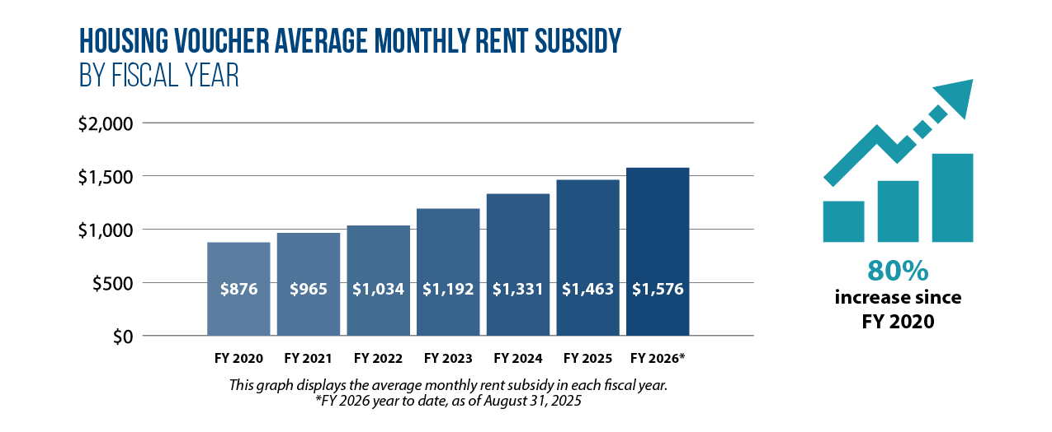
SDHC – FY 2026 MTW Annual Plan Amendment
Fiscal Challenges (Continued)
Rising Costs

Slide 6


SDHC – FY 2026 MTW Annual Plan Amendment
Fiscal Challenges (Continued)
FY2026 SDHC Budget Gap
$26.6 Million
Anticipated gap between allocated federal funds and SDHC’s actual Housing Assistance Payments
1,700
Approximate number of families currently in the program that
WOULD LOSE
their rental assistance
Notes:
Average voucher cost used is Aug 2025 for MTW alone - $1530

Slide 7
SDHC – FY 2026 MTW Annual Plan Amendment
Fiscal Challenges (Continued)
SDHC Cost-Containment
Ongoing analysis will result in reductions in SDHC staff, including leadership positions.
Multiple leadership positions left vacant through attrition.
10 additional positions that became vacant in the past three months will not be filled.
Other positions have not been filled after becoming vacant prior to this fiscal year.
No Performance Incentive Payments for Vice Presidents and above
No Cost-of-Living Adjustments for Senior Vice Presidents and above
SDHC Strategic Plan includes many cost containment and revenue generation initiatives, including a comprehensive review of all SDHC functions and the personnel needs, funding sources, and revenue associated with those functions. Determine which functions are mission-critical and which are ancillary. Identify where programs and activities may be adjusted to reduce costs and/or increase revenue.
Notes:
No Performance Incentive Payments for Vice Presidents and above $220K
No Cost-of-Living Adjustments for Senior Vice Presidents and above $89K
15 positions not backfilled – Average SDHC position is $150K – 155K equals nearly $2.3M in savings

Slide 8
SDHC – FY 2026 MTW Annual Plan Amendment
Fiscal Challenges (Continued)
SDHC Budget Projections
 | 2026 | 2027 | 2028 | 2029
 | Projections | Projections | Projections | Projections
SOURCES
Housing Assistance Payment (HAP) MTW Revenues | $254,395,096 | $256,204,637 | $258,792,304 | $261,406,106
MTW Admin Revenues | $19,650,948 | $19,191,481 | $19,191,481 | $19,191,481
TOTAL SOURCES | $274,046,044 | $275,396,118 | $277,983,785 | $280,597,587
USES
Total MTW HAP Expenses | $280,948,158 | $281,329,715 | $280,586,376 | $278,371,735
Other MTW Program and Administrative Expenses | $28,610,017 | $23,987,780 | $23,987,780 | $23,987,780
TOTAL OPERATING USES | $309,558,175 | $305,317,495 | $304,574,156 | $302,359,515
VOUCHER FUNDING DEFICIT | -$35,512,131 | -$29,921,377 | -$26,590,371 | -$21,761,928
Ending MTW Reserve Balance | $17,768,991 | -$12,152,386 | -$38,742,757 | -$60,504,685
Notes:
Verified Suket

Slide 9
SDHC – FY 2026 MTW Annual Plan Amendment
Fiscal Challenges (Continued)
SDHC Budget Projections with Path to Success Savings
 | 2026 | 2027 | 2028 | 2029
 | Projections | Projections | Projections | Projections
SOURCES
HAP MTW Revenue | $254,395,096 | $256,204,637 | $258,792,304 | $261,406,106
MTW Admin Revenues | $19,650,948 | $19,191,481 | $19,191,481 | $19,191,481
TOTAL SOURCES | $274,046,044 | $275,396,118 | $277,983,785 | $280,597,587
USES
Total MTW HAP Expenses | $280,948,158 | $281,329,715 | $280,586,376 | $278,371,735
Other MTW Program and Administrative Expenses | $28,610,017 | $23,987,780 | $23,987,780 | $23,987,780
TOTAL OPERATING USES | $309,558,175 | $305,317,495 | $304,574,156 | $302,359,515
VOUCHER FUNDING DEFICIT | -$35,512,131 | -$29,921,377 | -$26,590,371 | -$21,761,928
Path to Success Savings | - | $9,674,088 | $31,173,948 | $31,173,948
Ending MTW Reserve Balance | $17,768,991 | -$2,478,298 | $2,105,279 | $11,517,299
Notes:
Verified Suket

Slide 10
SDHC – FY 2026 MTW Annual Plan Amendment
Options
Option 1
End rental assistance for approximately 1,700 households
Option 2
Approve and implement recommended updates to SDHC’s Path to Success Initiative to continue to assist approximately 14,500 existing families

Slide 11
SDHC – FY 2026 MTW Annual Plan Amendment
Moving to Work and
Recommended Path to Success Updates

Slide 12
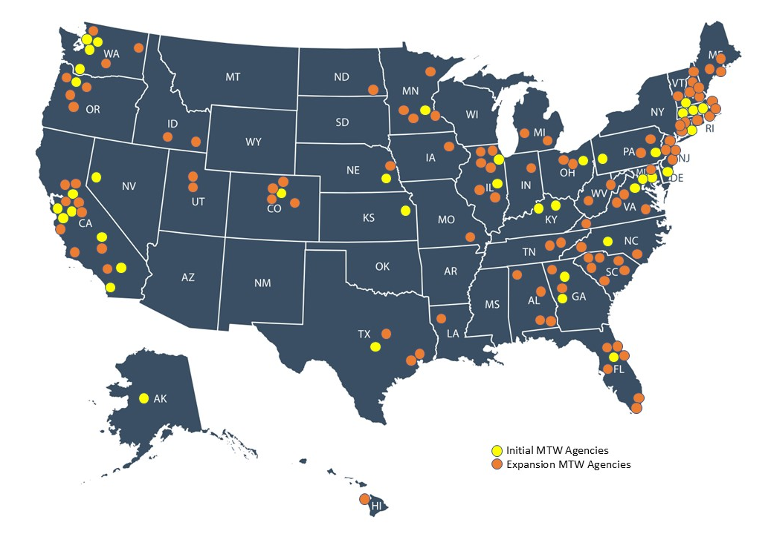
SDHC – FY 2026 MTW Annual Plan Amendment
What is MTW?
MTW is a demonstration program for public housing authorities (PHAs) that provides them flexibilities to design and test innovative, locally designed strategies.
SDHC is one of 39 original MTW agencies out of approximately 3,200 public housing authorities nationwide.
A total of 138 agencies now have MTW status either under the original agreement or as an expansion agency.
Three Statutory MTW Objectives:
Reduce costs (increase efficiency) in federal expenditures
Help families to become economically self-sufficient.
Improve housing choices for families.

Slide 13
SDHC – FY 2026 MTW Annual Plan Amendment
Recommended Path to Success Updates – Reproposed Activity 2012-1
Path to Success Overview
Rent Reform initiative implemented July 1, 2013.
Developed with SDHC’s MTW flexibility.
Defines households as able to work (Work-Able) or Elderly/Disabled
 | Work-Able | Elderly / Disabled
Factors That Determine Household Type | Under 62 | 62 or older
 | Not Disabled | Disabled
 | AND | OR
 | Not a full-time student ages 18-23 | A full-time student ages 18-23
Family’s Contribution to the Rent | Pay either the minimum family contribution or a family contribution amount based on a percentage family’s income, whichever is greater. | Pay 28.5 percent of adjusted monthly income.
 | Minimum Family Contribution One Work-Able Adult: $400/month Two or more Work-Able Adults: $650/month | Minimum Family Contribution: $0
 | The family’s contribution amount is calculated on the lower edge of an income range. Families pay 24-30% of their income. Example: If annual income is between $25,000 and $29,999, SDHC will use $25,000 to calculate the family’s portion of the rent.

Slide 14
SDHC – FY 2026 MTW Annual Plan Amendment
Recommended Path to Success Updates – Reproposed Activity 2012-1
(Continued)
Family Contribution (FC) Determination
Work-Able Households Only
Expand to include an additional minimum FC for three or more Work-Able adults
Calculate FC at 40% of adjusted income
No longer use income ranges for FC calculations
Update minimum FC amounts based on minimum wage increases in recent years ($17.75/hour effective January 2026)

Slide 15
SDHC – FY 2026 MTW Annual Plan Amendment
Recommended Path to Success Updates – Reproposed Activity 2012-1
(Continued)
Family Contribution (FC) Determination
Recommended Minimum FC for Work-Able Households Only
1 Work-Able Adult | 2 Work-Able Adults | 3 or More Work-Able Adults
$580/month | $1,155/month (approximately $578 per person) | $1,735/month (approximately $578 per person)
Minimum FC is approximately 30% of monthly income working 25 hours/week at $17.75/hour ($576.88). | Minimum FC is approximately 30% of monthly income with two adults each working 25 hours/week at $17.75/hour ($1,153.75). | Minimum FC is approximately 30% of monthly income with three adults each working 25 hours/week at $17.75/hour ($1,730.63).
Elderly/Disabled FC would increase to 32% of adjusted income instead of 28.5%.
No minimum FC for Elderly/Disabled households

Slide 16
SDHC – FY 2026 MTW Annual Plan Amendment
Recommended Path to Success Updates – Reproposed Activity 2012-1
(Continued)
Household Impact Analysis and Hardship Policy

Slide 17
SDHC – FY 2026 MTW Annual Plan Amendment
Recommended Path to Success Updates – Reproposed Activity 2012-1
(Continued)
Household Impact – Elderly/Disabled Households
Family Contribution (FC) = 32% of adjusted household income (3.5% increase from 28.5%)
FC Increase Per Month | # of Households
$0 - $99 | 8,713
$100 - $199 | 617
$200 - $299 | 31
$300 - $350 | 2
Total | 9,363

Slide 18
SDHC – FY 2026 MTW Annual Plan Amendment
Recommended Path to Success Updates – Reproposed Activity 2012-1
(Continued)
Household Impact – Work-Able Households
Number of Households Subject to Minimum Family Contribution: 1,890
Work Able 1 – 876
Work Able 2 – 609
Work Able 3+ – 405
Number of Households Subject to 40% of Adjusted Income: 3,060
Work Able 1 – 2,033
Work Able 2 – 769
Work Able 3+ – 258

Slide 19
SDHC – FY 2026 MTW Annual Plan Amendment
Recommended Path to Success Updates – Reproposed Activity 2012-1
(Continued)
Household Impact – Work-Able Households (Continued)
Work Able Households Paying Minimum FC
Work-Able Households Paying 40% of Income
FC Increase Per Month | # of Households
$100 - $199 | 847
$200 - $299 | 2
$300 - $399 | 8
$400 - $499 | 125
$500 - $599 | 506
$600 - $699 | 57
$700 - $799 | 57
$800 - $899 | 57
$900 - $999 | 46
$1,000+ | 185
Total | 1,890
FC Increase Per Month | # of Households
$100 - $199 | 85
$200 - $299 | 499
$300 - $399 | 678
$400 - $499 | 689
$500 - $599 | 518
$600 - $699 | 298
$700 - $799 | 161
$800 - $899 | 73
$900 - $999 | 31
$1,000+ | 28
Total | 3,060

Slide 20
SDHC – FY 2026 MTW Annual Plan Amendment
Recommended Path to Success Updates – Reproposed Activity 2012-1
(Continued)
Hardship
Eligibility
Households with 1 Work-Able adult or 2 Work-Able adults
At least one dependent in the household
Currently at the minimum FC
Terms
Six-month hardship if the household pays more than 50% of its income per month toward rent.
Household FC will be adjusted to $50, their previous FC, or 50% of their adjusted income—whichever is greater.
While on the hardship, the head of household will be required to sign a document consenting to participate in self-sufficiency activities, which may include:
Attending work-readiness classes
Applying for benefits
Regaining employment, etc.
The household will be referred to the SDHC Achievement Academy to work with a Work Readiness Specialist during their hardship period.

Slide 21
SDHC – FY 2026 MTW Annual Plan Amendment
Recommended Path to Success Updates – Reproposed Activity 2012-1
(Continued)
Robust Noticing Period
Obtain approval from the U.S. Department of Housing and Urban Development (HUD).
First Notice to Housing Choice Voucher families.
Ongoing notices leading up to implementation.
Notices will explain updates to the Family Contribution calculation, why the updates were necessary, and how the updates will impact households.
Notices will include information on resources to help households increase their income in preparation for the updates, such as the SDHC Achievement Academy and partnerships with nonprofit organizations.
Updates will be applied within Fiscal Year 2027.

Slide 22
SDHC – FY 2026 MTW Annual Plan Amendment
Recommended Path to Success Updates – Reproposed Activity 2012-1
(Continued)
Public Comment
October 31 – November 30: Public Comment Period
Public comment information posted on SDHC's website.
Public notice published in Voice & Viewpoint, El Latino, and the San Diego Union-Tribune.
Letter mailed to random sample of participants, and email sent to all Housing Choice Voucher heads of households for whom SDHC has an email address.
November 7, 2025: SDHC Board of Commissioners Informational Workshop
November 17, 2025: Public hearing held at SDHC’s offices.
December 11, 2025: SDHC Board of Commissioners Special Meeting to consider action item

Slide 23
SDHC – FY 2026 MTW Annual Plan Amendment
Recommended Path to Success Updates – Reproposed Activity 2012-1
(Continued)
Remaining Uncertainties
With unprecedented changing federal priorities, reserves may be at risk.
Federal funding may be less than what is anticipated.
Ongoing federal budget uncertainty in coming years.

Slide 24
SDHC – FY 2026 MTW Annual Plan Amendment
Recommended Path to Success Updates – Reproposed Activity 2012-1
(Continued)
Summary
When a federal Continuing Resolution or Budget is approved, it will not provide sufficient funding to resolve the Voucher Funding Deficit SDHC is experiencing.
Approximately 1,700 families (approximately 6,000 individuals) currently in the Housing Choice Voucher program WOULD LOSE their rental assistance unless recommended updates to Path to Success are implemented.
SDHC’s average Housing Assistance Payment expenses have risen 80% since Fiscal Year 2020.
Minimum Family Contribution has not been adjusted since January 2020.
Recommended updates to Path to Success will produce Housing Assistance Payment savings that should enable SDHC to continue to assist current participating rental assistance households.

Slide 25
SDHC – FY 2026 MTW Annual Plan Amendment
Public Comments

