Slide 1

San Diego Housing Commission (SDHC)
Fiscal Year (FY) 2020 Proposed Budget
(July 1, 2019 - June 30, 2020)
Housing Authority Agenda Item #1
June 10, 2019
Jeff Davis
Executive Vice President and Chief of Staff
Tracey McDermott
Senior Vice President and Chief Financial Officer

Slide 2
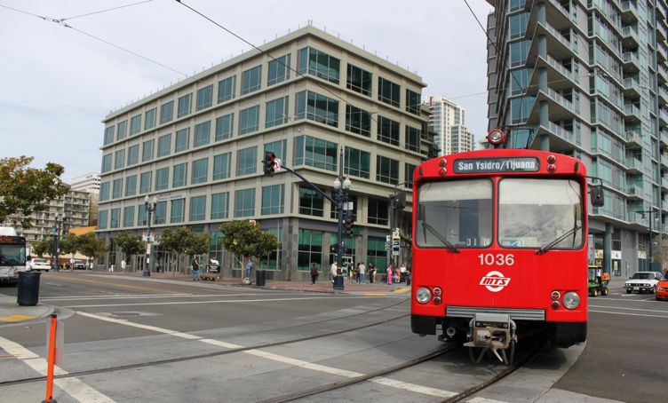
SDHC FY 2020 Proposed Budget
Overview
$452 Million in Total Funding Sources
SDHC Headquarters
1122 Broadway
Downtown San Diego

Slide 3
SDHC FY 2020 Proposed Budget
Where we’ve been and where we’re going in 2020

Slide 4
SDHC FY 2020 Proposed Budget
New Revenue by Major Category
$331M ($ in Millions)
FY 2020 New Revenue Total: $331M

Slide 5
SDHC FY 2020 Proposed Budget
Funding Uses by Division (Excluding Ending Reserves)
$351M ($ in Millions)

Slide 6
SDHC FY 2020 Proposed Budget
Summary – Staffing by Division

Slide 7
SDHC FY 2020 Proposed Budget
Approval Request
FY 2020 Budget - $452 Million

Slide 8

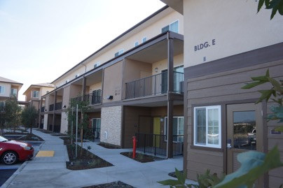

SDHC FY 2020 Proposed Budget
Rental
Assistance
Creating Affordable Housing
Solutions To Homelessness
Thank You

